Slide 1
SC1015 Mini Project
Lab Group Z130 Team 1
Wong Liek Zhe (U2220416D) Iain Roderick Tay (U2221382K)
Tan Jie Ning, Jolynn (U2220577B)

Slide 2
Table of contents
03
01
02
04
05
Exploratory Data Analysis
Motivation
Datasets
Analysis/ Machine Learning
Outcomes and Data Driven Insights

Slide 3
01
Motivation

Slide 4




Motivation
What is the most successful movie out there?
Could there have been a more successful one?

Slide 5
Motivation
That is why our…
GOAL =
The biggest factors that plays a significant role in determining the SUCCESS of a movie

Slide 6
02
Dataset

Slide 7


Dataset
The dataset we will be using is from

Slide 8
03
Exploratory Data Analysis

Slide 9
Exploratory Data Analysis
How do we define successful?
The most POPULAR and PROFITABLE movie
SUCCESSFUL =

Slide 10
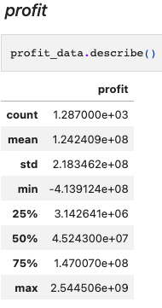
Exploratory Data Analysis
Initial Data Driven Insights
Noticed that the minimum value of profit is negative, indicating that that movie made a loss in revenue

Slide 11
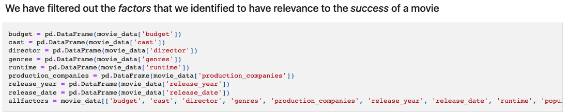
Exploratory Data Analysis
Filtering of Data
Filtered out factors that was relevant in determining the success of a movie

Slide 12
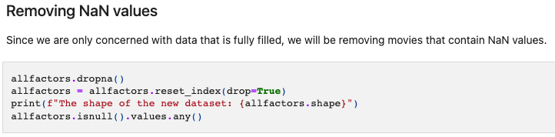
Exploratory Data Analysis
Removing NaN values

Slide 13
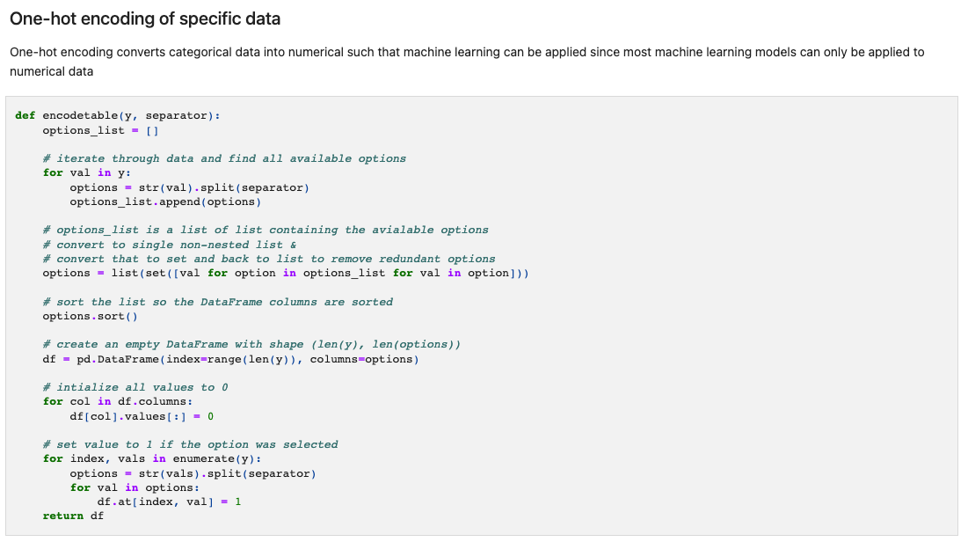
Exploratory Data Analysis
Encoder Function
Convert categorical values into numerical values for better analysis

Slide 14
Exploratory Data Analysis
Planning Analysis and Machine Learning
Linear Regression Model
Numerical Values
Random Forest Classification
Categorical Values
Correlation

Slide 15
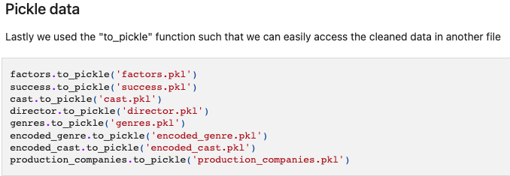
Exploratory Data Analysis
Pickling of Data
Cleaned and prepped to converted into a pickle file for other files to easily extract it

Slide 16
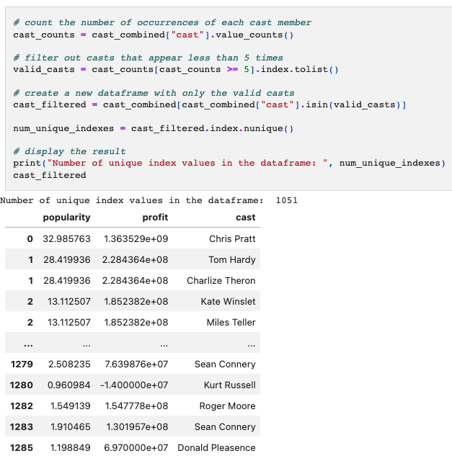
Exploratory Data Analysis
Dimension reduction
Removing noisy data by only including variables that have a frequency higher than 5

Slide 17
Exploratory Data Analysis
New techniques that we have used that was not used in this course
Encoding of categorical factors
New Techniques
Pickling of data

Slide 18
04
Analysis/
Machine Learning

Slide 19
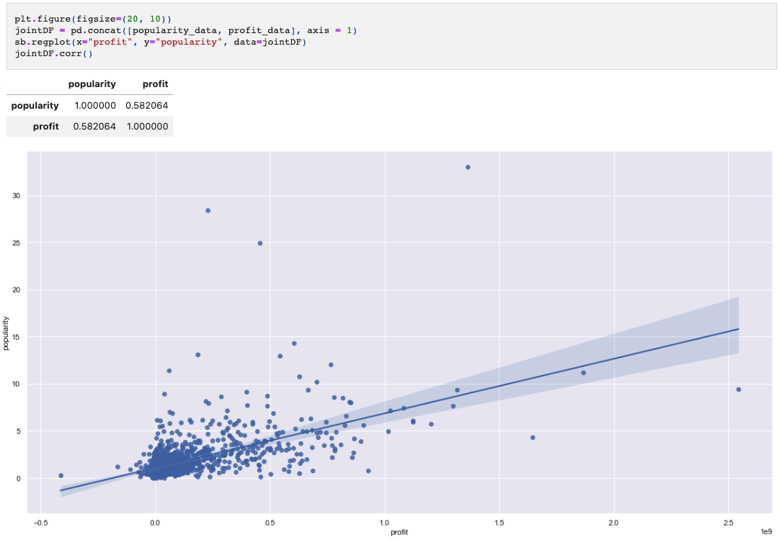
Analysis/ Machine Learning
Linear Regression of Success Factors
Plotted a scatterplot of popularity and profit and noticed there is a positive linear correlation between the two with a correlation of 0.582 indicating a fairly strong correlation

Slide 20
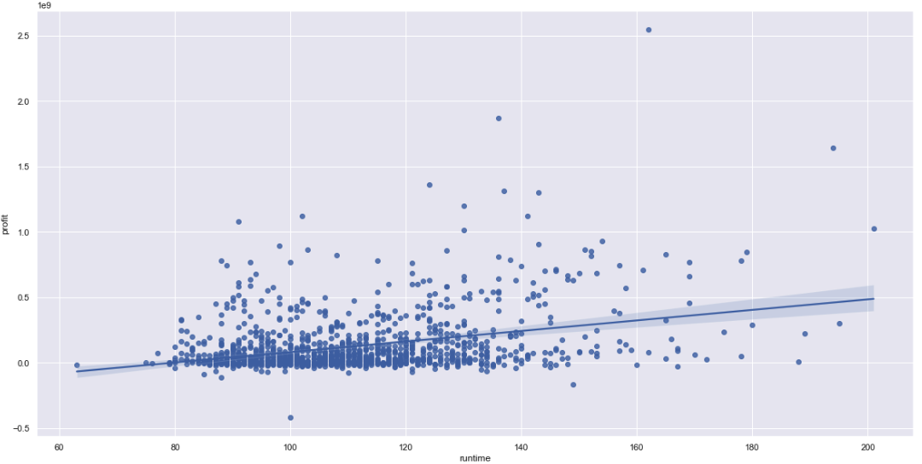
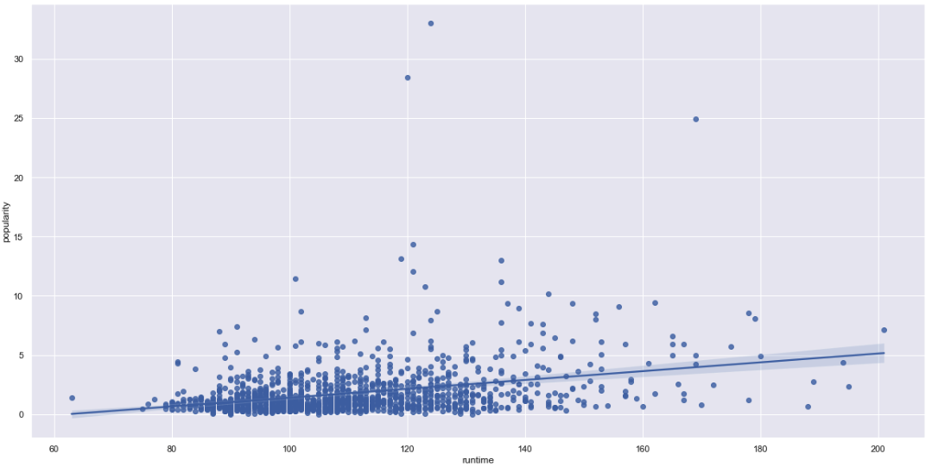
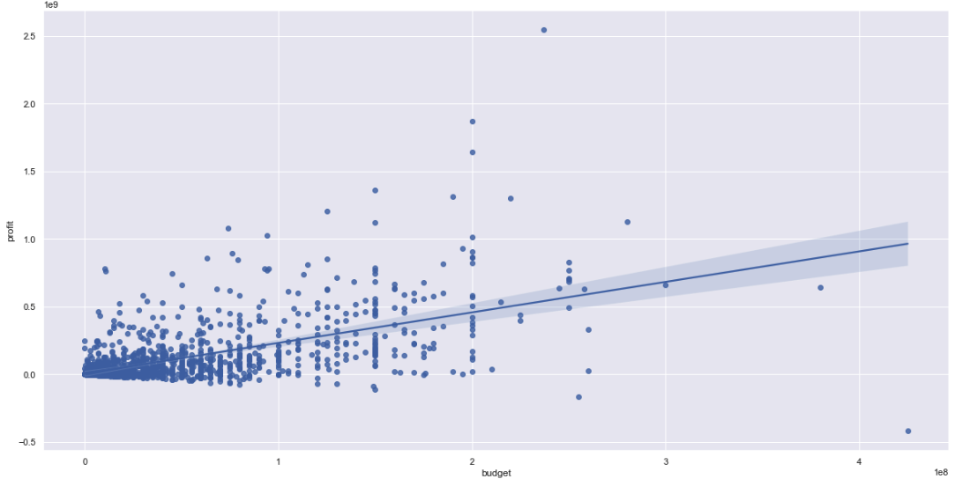
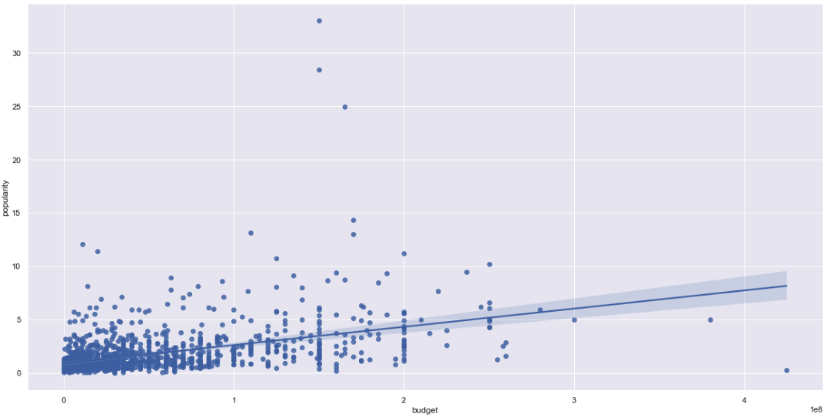
Analysis/ Machine Learning
Linear Regression of Numerical Factors
Scatterplot of all numeric factors against all success factors

Slide 21
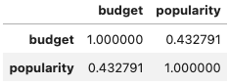
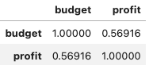
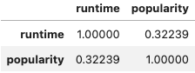
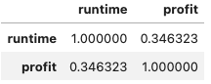
Analysis/ Machine Learning
Budget Correlation
The correlation of budget with popularity and profit is 0.432 and 0.569 respectively, and the correlation value of runtime with popularity and profit is 0.322 and 0.346

Slide 22
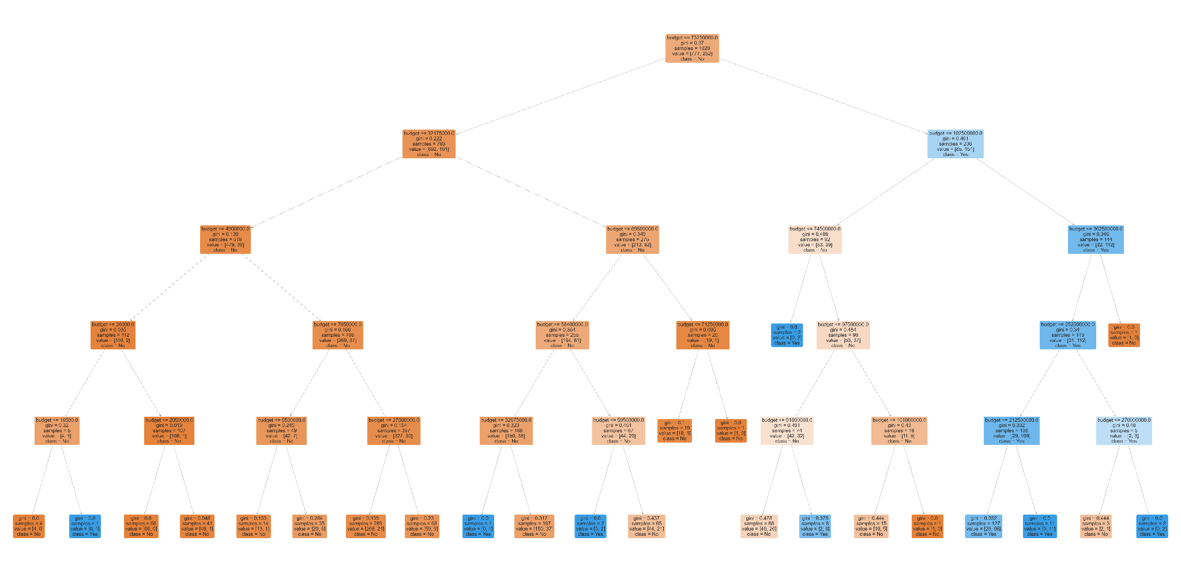
Analysis/ Machine Learning
Decision Tree - Budget & Popularity

Slide 23
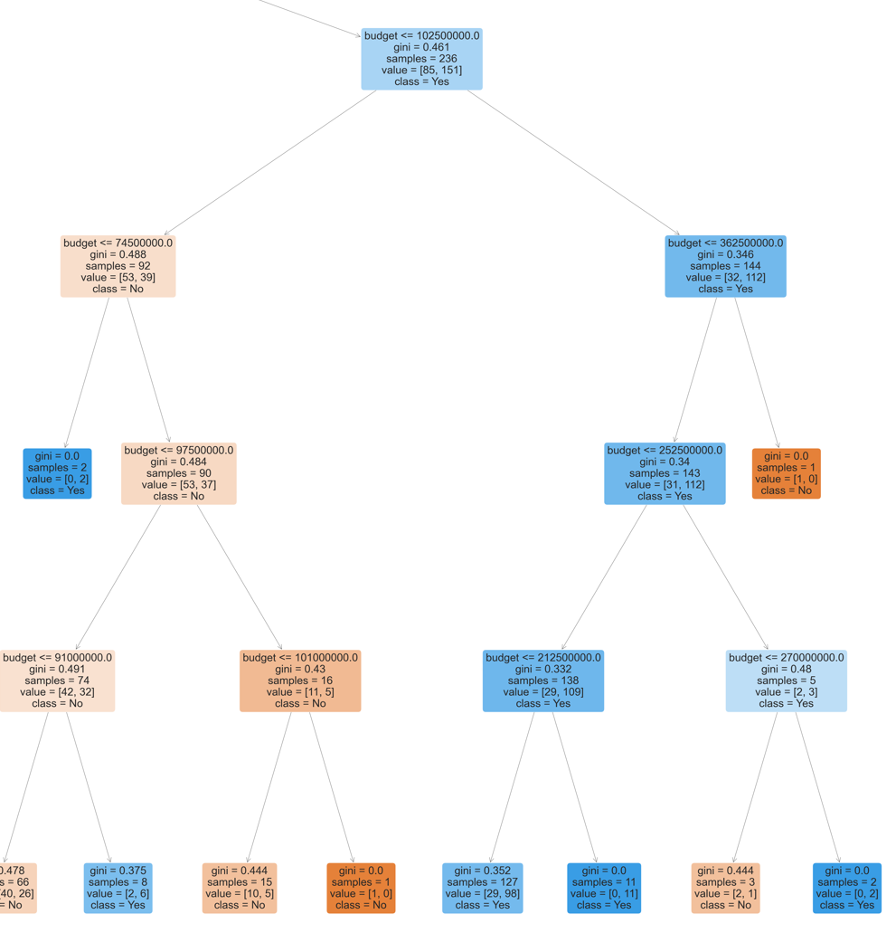
Decision Tree - Budget & Popularity
Most POPULAR movies have a budget:
270.0mill USD to 362.5mill USD (Gini = 0.0)
102.5mill USD TO 252.5mill USD (Gini <= 0.34)

Slide 24
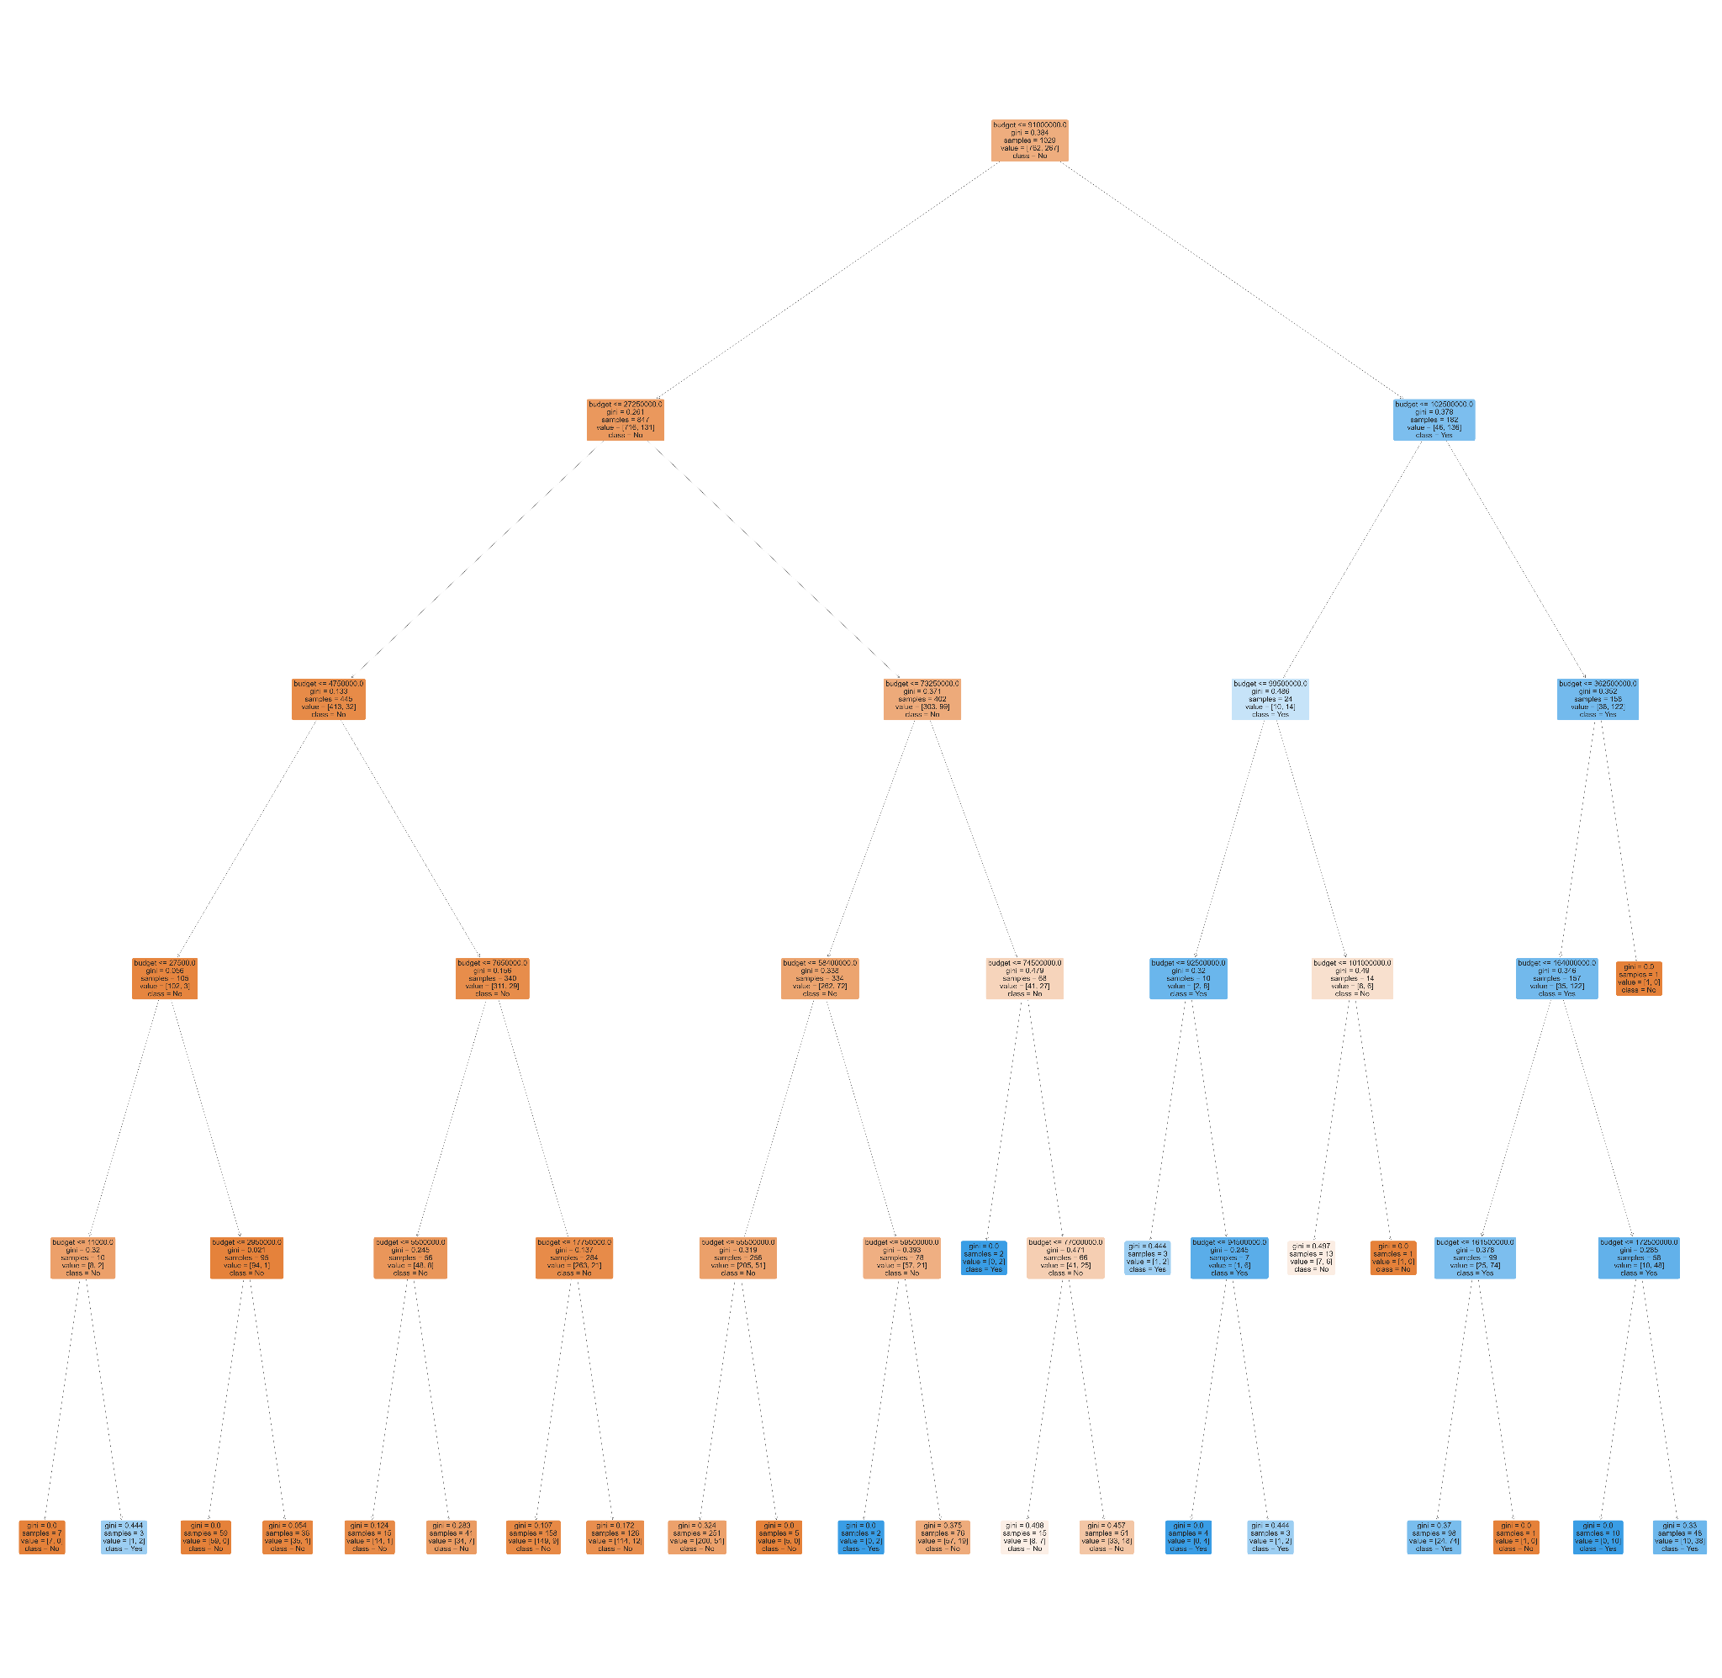
Analysis/ Machine Learning
Decision Tree - Budget & Profit

Slide 25
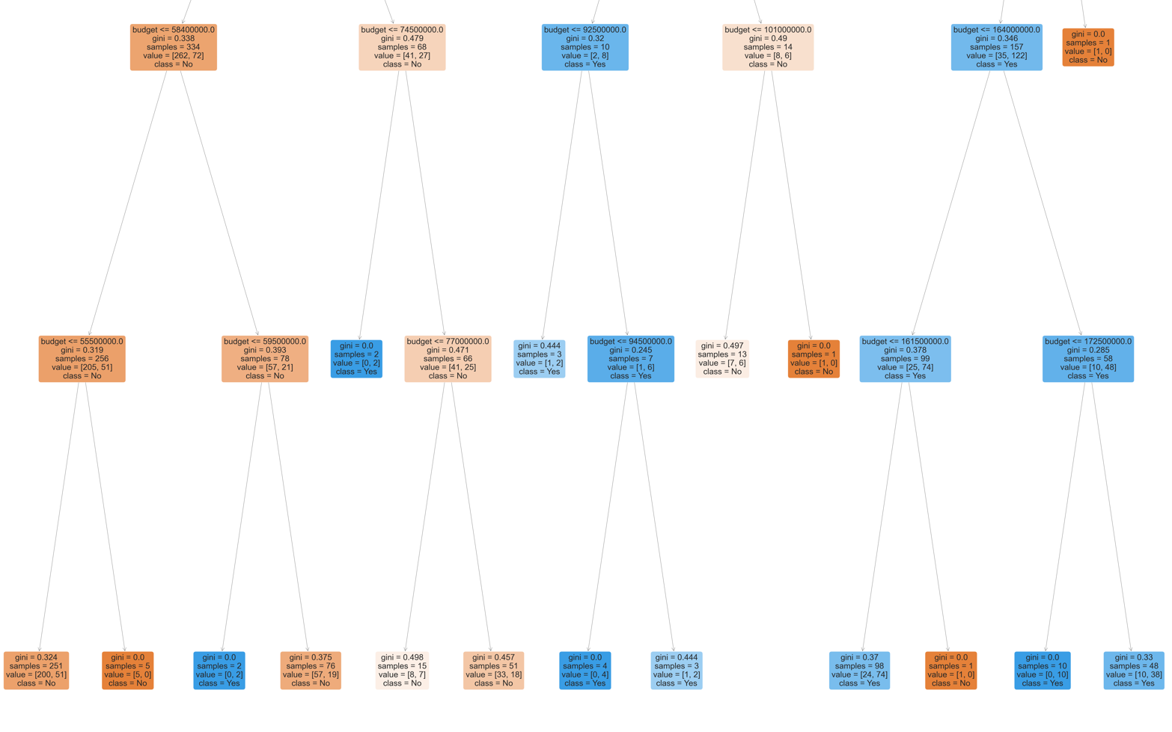
Random Forest Classification - budget & profit
Most PROFITABLE movies have a budget:
92.5mill USD to 99.5mill USD (Gini <= 0.32)
164.0 USD TO 172.5mill USD (Gini <= 0.285)

Slide 26
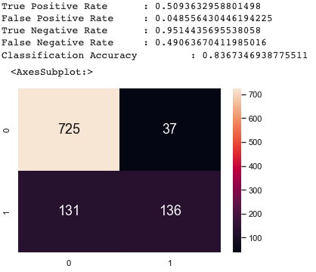
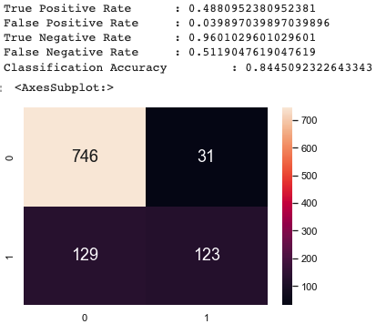
Analysis/ Machine Learning
Confusion Matrix
Crafted a confusion matrix to calculate the classification accuracy for budget with success factors

Slide 27
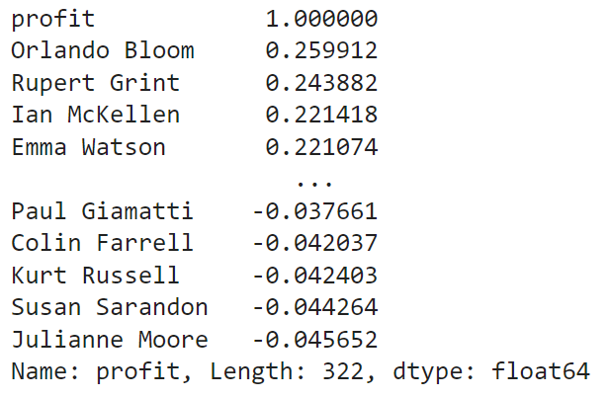
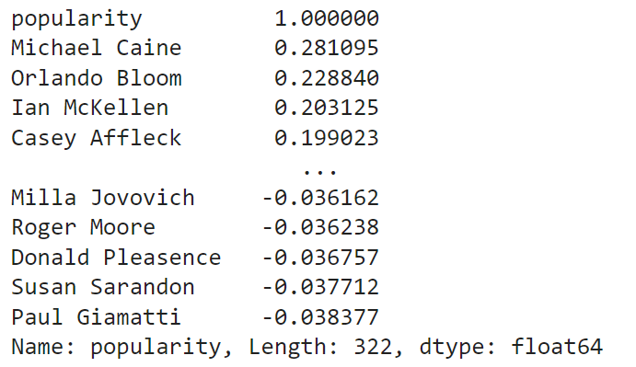
Analysis/ Machine Learning
CAST & Success Correlation
PROFIT
POPULARITY

Slide 28
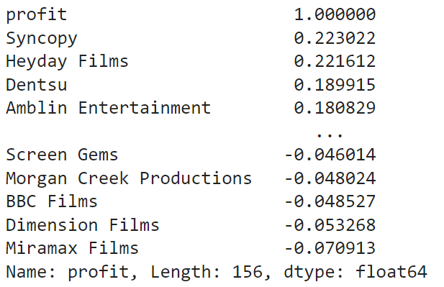
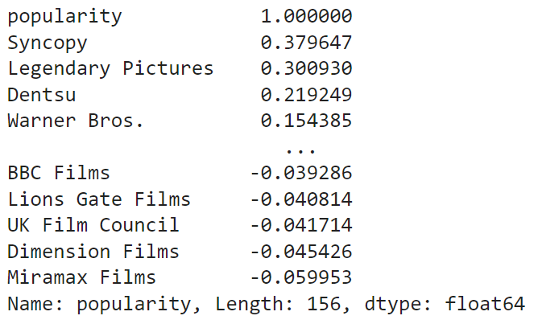
Analysis/ Machine Learning
PRODUCTION COMPANY & Success Correlation
PROFIT
POPULARITY

Slide 29
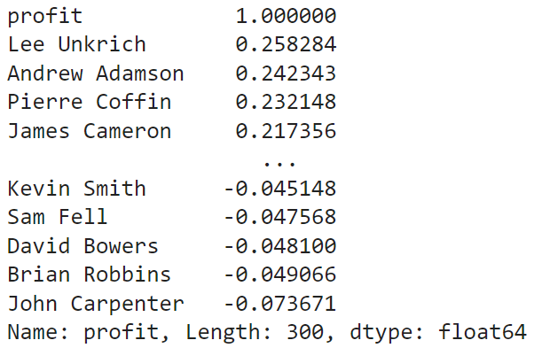
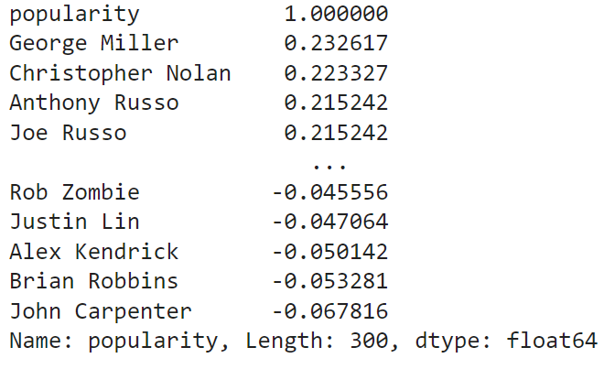
Analysis/ Machine Learning
DIRECTOR & Success Correlation
PROFIT
POPULARITY

Slide 30
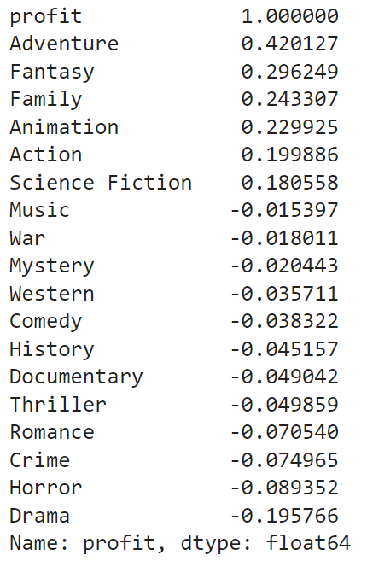
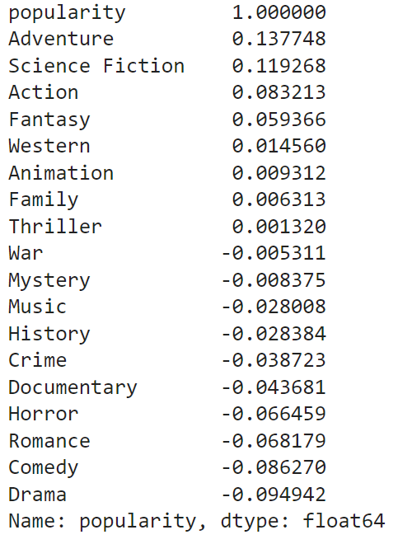
Analysis/ Machine Learning
GENRE & Success Correlation
PROFIT
POPULARITY

Slide 31
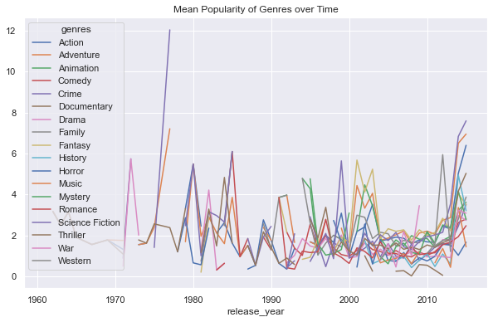
Analysis/ Machine Learning
PIVOTED GRAPH OF MEAN POPULARITY OF GENRES OVER TIME

Slide 32
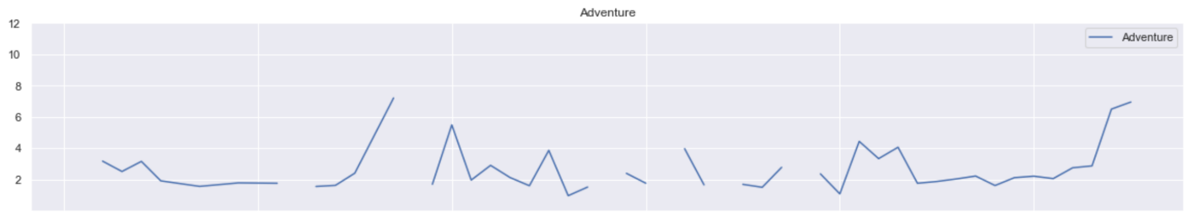
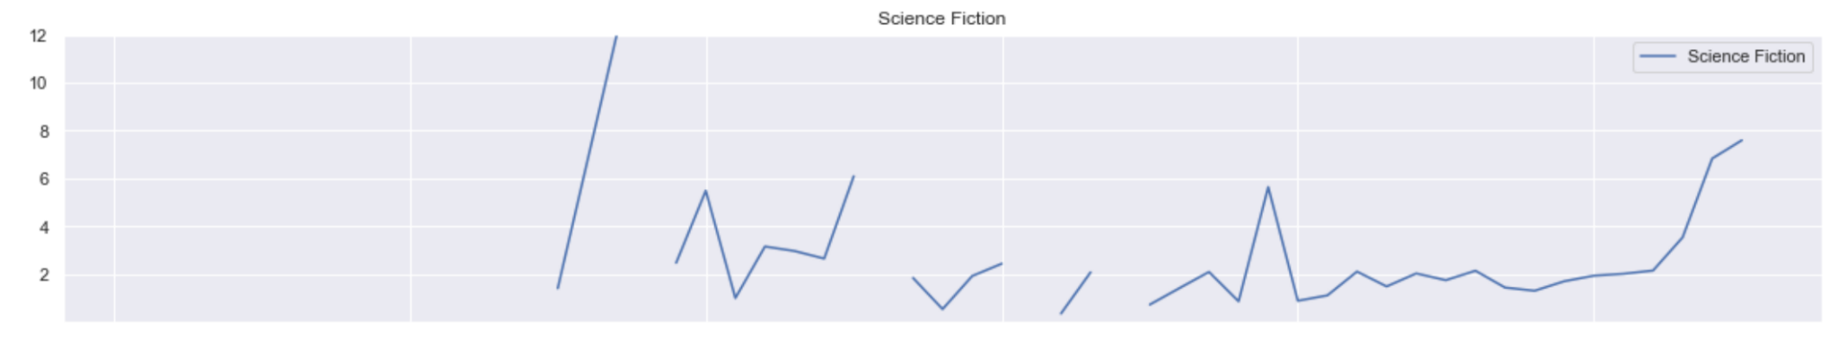
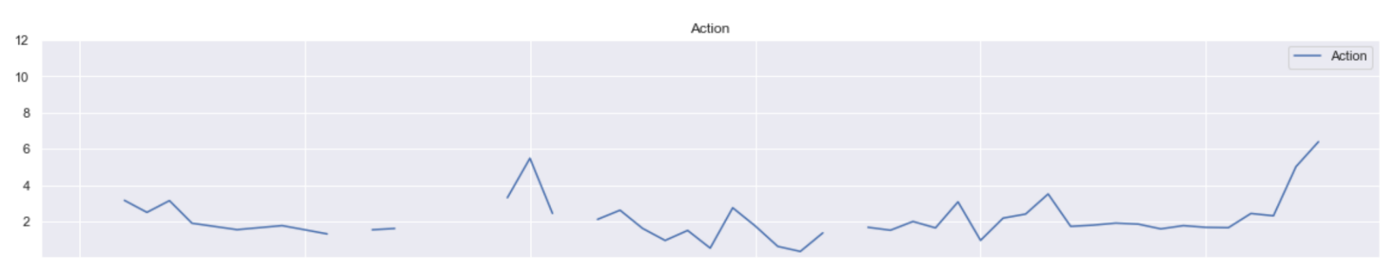
PIVOTED GRAPH OF MEAN POPULARITY OF GENRES OVER TIME
ADVENTURE
SCIENCE FICTION
ACTION

Slide 33
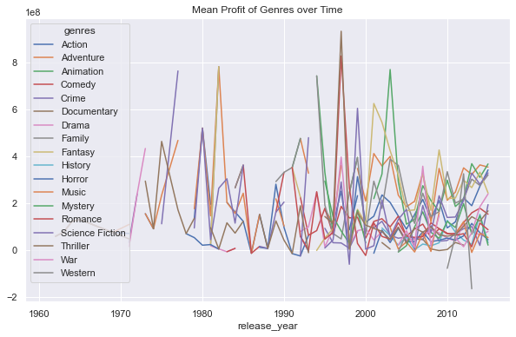
Analysis/ Machine Learning
PIVOTED GRAPH OF MEAN PROFIT OF GENRES OVER TIME

Slide 34
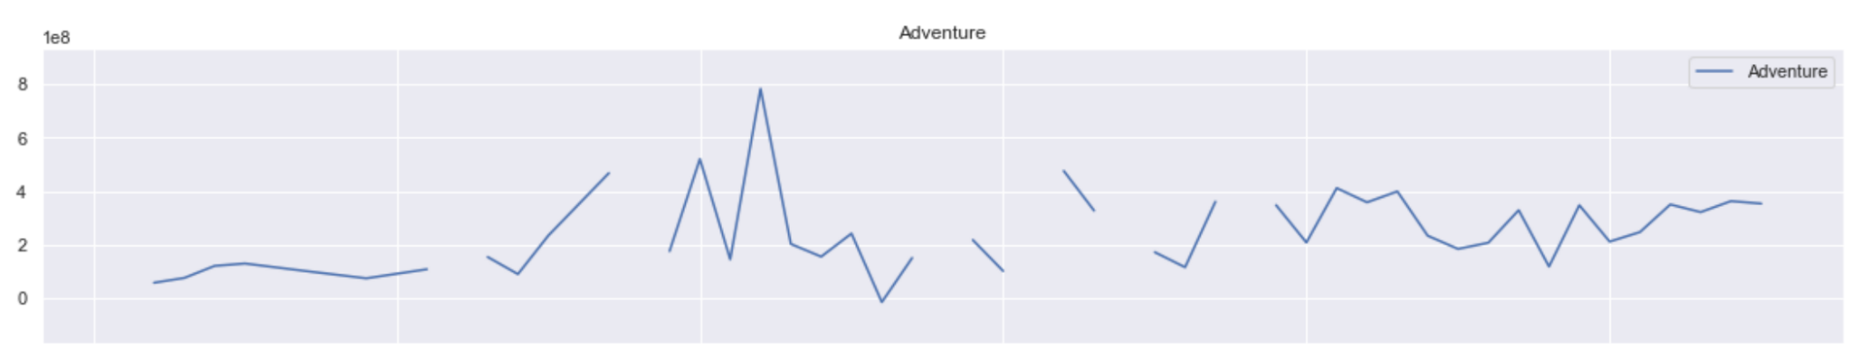
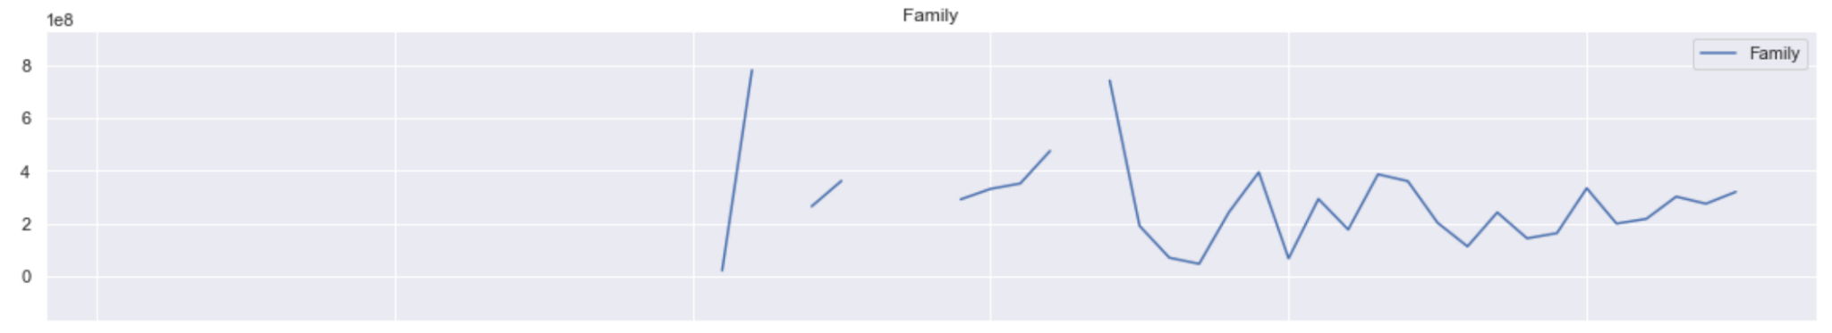
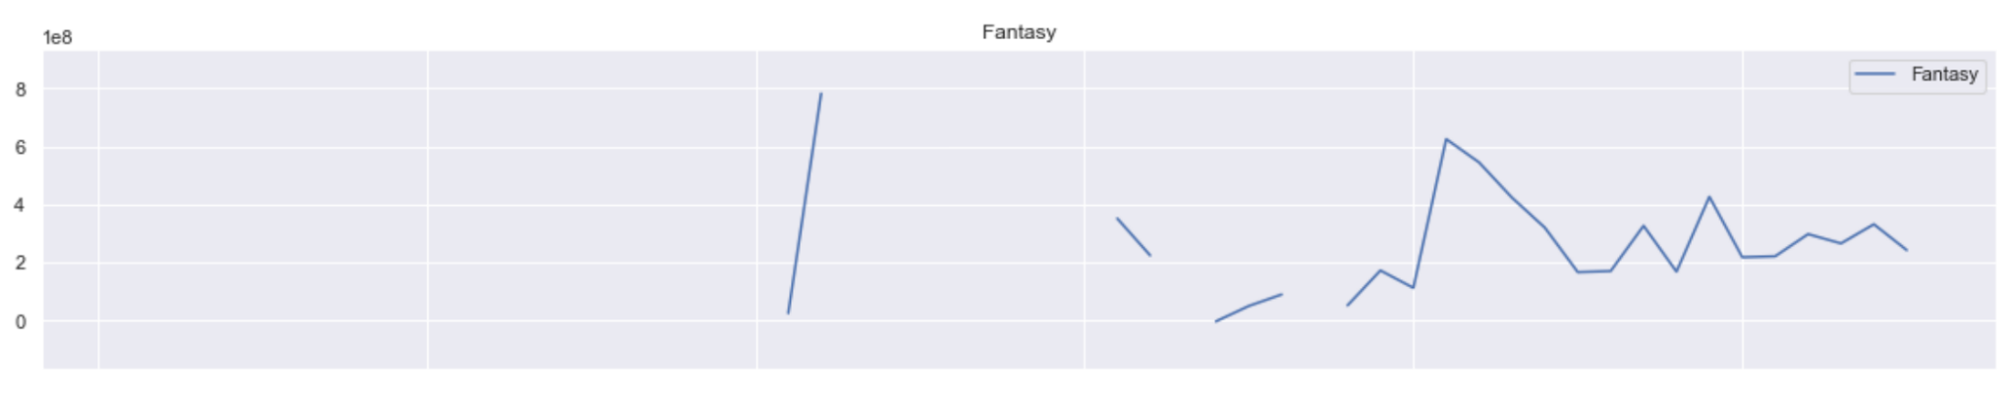
PIVOTED GRAPH OF MEAN PROFIT OF GENRES OVER TIME
ADVENTURE
FANTASY
FAMILY

Slide 35
Analysis/ Machine Learning
CORRELATION OF CATEGORICAL & NUMERIC DATA
SUCCESS | CATEGORICAL |  |  |  | NUMERIC
 | GENRE | DIRECTORS | CAST | PRODUCTION COMPANY | BUDGET | RUNTIME
POPULARITY | 0.138 | 0.232 | 0.281 | 0.380 | 0.432 | 0.322
PROFIT | 0.420 | 0.258 | 0.260 | 0.223 | 0.569 | 0.346

Slide 36
05
OUTCOME & DATA DRIVEN INSIGHTS

Slide 37
Outcome and Data Driven Insights
Final Outcome: Best Factors
Numerical Factors
Budget
Categorical Factors
Genre

Slide 38
WHAT WOULD BE THE BEST COMBINATION FOR THE MOST SUCCESSFUL MOVIE?
Venus
Mercury
Venus has a beautiful name and is the second planet from the Sun
Mercury is the closest planet to the Sun and the smallest one of them all

Slide 39

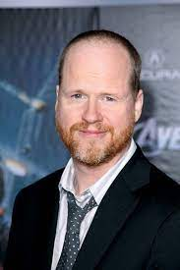






Max profit
Max popularity

Slide 40

Outcome and Data Driven Insights
It is important to keep in mind that high correlation does not equate to causation and likewise, low correlation does not mean that the determining factors does not affect the success factors. Therefore, it is still important to analyse factors that do not present a high correlation with the success factors.

Slide 41
Outcome and Data Driven Insights
“Film is not the art of scholars, but of illiterates”
Renowned filmmaker, Werner Herzog

Slide 42
“CONDITIONS” FOR A SUCCESS MOVIE
SUCCESS | CATEGORICAL
 | GENRE | DIRECTORS | CAST | PRODUCTION COMPANY
POPULARITY | Science Fiction | George Miller | Chris Pratt | LucasFilm
PROFIT | Fantasy | Joss Whendon | Rupert Grint | Syncopy

Slide 43
CONDITIONS FOR A SUCCESS MOVIE
SUCCESS | NUMERIC
 | BUDGET | RUNTIME
POPULARITY |  | Not a good indicator
PROFIT

Slide 44
Thanks!

